Slide 1

UE21CS390A – Capstone Project Phase – 1
Project Progress Review #2
(Project Requirements Specification and Literature Survey)
Project Title : Generating Clear speech from Speech impaired
Audio
Project ID : PW24_RS_03
Project Guide : Dr. Ramamoorthy Srinath
Project Team with SRN : Roseline Jerry A - PES1UG21CS500
T P Shriambhikesh - PES1UG21CS659
Tanmay Praveen Udupa - PES1UG21CS662
Vandana S - PES1UG21CS697

Slide 2
Generating clear speech from impaired audio
Agenda
Abstract
Suggestions from Review-1
Constraints
Assumptions
Risks
Functional Requirements
Non functional Requirements
Literature Survey
Parrotron Paper
Project Euphonia
Articulatory features of ASR for Pathological speech
Arabic Dysarthric Speech Recognition Using Adversarial and Signal-Based Augmentation
Conclusions
References

Slide 3
Generating clear speech from impaired audio
Abstract
Effective communication is essential for individuals to express themselves, convey ideas, and connect with others. However, for people with speech impairments this can be challenging. Whether caused by medical conditions, developmental disorders, or other factors, speech difficulties often create barriers to clear and understandable communication.
In response to this challenge our project aims to develop a solution that enhances impaired speech outputs, ensuring clearer communication for these individuals.

Slide 4
Generating clear speech from impaired audio
Abstract
Overview of Scope:
Development of generic speech synthesis system
Providing clear and natural sounding speech
Real time Adaptations
User friendly interactions and Customization
Integration of feedback mechanism
Ethical standards and privacy considerations
Collaboration with Healthcare professionals

Slide 5
Generating clear speech from impaired audio
Suggestions from Review - 1
Treating impaired speech as a Different language :
It was suggested to treat impaired speech as a distinct language to better understand its characteristics. This approach could involve analysing speech patterns, phonetic variations unique to individuals with speech impairment.
Ensuring effectiveness of feedback mechanism:
These mechanisms play a crucial role in gathering user input, evaluating performance of the ML model and identifying areas of improvement. It's important that the feedback mechanism is user friendly and capable of catching relevant insights to further improve it.
(multimodality)

Slide 6
Generating clear speech from impaired audio
Constraints
Legal implications:
The project must adhere to legal regulations and standards governing speech synthesis, privacy, and data protection.Intellectual property rights must be considered when utilizing proprietary algorithms or datasets in the development of the speech synthesis system.
Software/Hardware requirements: This includes access to computational resources for training and deploying the speech synthesis model, as well as compatibility with operating systems and development environments. Dependencies on third-party libraries, frameworks, or APIs must also be considered and managed effectively.
Ethical Considerations, Privacy and Security etc

Slide 7
Generating clear speech from impaired audio
Dependencies
Hardware and Software Infrastructure:
The software's performance relies on the host computer's hardware and network infrastructure, necessitating their availability and proper functioning.
Speech Synthesis Algorithms:
The project relies on effective speech synthesis algorithms to generate natural-sounding speech output, with a focus on optimizing them for individuals with speech impairments.
User Engagement and Feedback:
The success of the project relies on active user engagement and feedback, requiring effective strategies for soliciting and incorporating user insights into testing, evaluation, and improvement process

Slide 8
Generating clear speech from impaired audio
Assumptions
Availability of sufficient data:
This project assumes access to sufficient and diverse datasets of impaired speech samples, for training and testing the speech synthesis model. This includes data representing various types and degrees of speech impairments to ensure the robustness and generalizability of the system.
Collaboration with Health professionals:
The project assumes collaboration with speech therapists, healthcare professionals, and other domain experts to validate the effectiveness of the speech synthesis system and align with therapeutic goals. This collaboration is essential for understanding user needs, gathering feedback, and ensuring the ethical and responsible development of the application.

Slide 9
Generating clear speech from impaired audio
Risks
Low Testing Accuracy: Variability in speech patterns, background noise, and individual speech impairments may lead to lower accuracy rates during testing.
Errors/Bugs: Algorithm implementation issues, data preprocessing problems, or integration errors with other software components could result in functional and reliability issues, leading to incorrect speech conversions or system failures.
Data Bias and Imbalance: Training data may exhibit bias or imbalance, such as overrepresentation or underrepresentation of certain speech patterns or demographics, impacting the model's performance, especially for individuals with less common speech impairments or diverse linguistic backgrounds.
Regulatory Compliance: Compliance with data protection laws and medical device regulations is crucial, especially for healthcare applications. Non-compliance may lead to legal consequences, financial penalties, or reputational damage.

Slide 10
Generating clear speech from impaired audio
Functional Requirements
Speech-to-Text Conversion
Accurate speech recognition technology for various accents, dialects, and speech impairments.
Robust handling of background noise and environmental factors.
Ability to detect and handle multiple speakers in a conversation or audio stream.

Slide 11
Generating clear speech from impaired audio
Functional Requirements
2. Text Correction:
Natural language processing techniques to identify and correct errors, and impaired speech patterns.
Ability to learn and adapt to individual users' speech patterns and improve correction accuracy over time.

Slide 12
Generating clear speech from impaired audio
Functional Requirements
3. Text-to-Speech Conversion:
High-quality speech synthesis with natural intonation and pronunciation.
Ability to handle complex text inputs, including proper names, abbreviations, numbers, and special characters.
Efficient memory and resource management for handling large or continuous text inputs.

Slide 13
Generating clear speech from impaired audio
Functional Requirements
4. User Feedback on Speech Output:
Incorporation of user feedback into machine learning
models or algorithms to improve speech synthesis.
Ability to capture and analyze user feedback data to identify areas for improvement.

Slide 14
Generating clear speech from impaired audio
Non - Functional Requirements
1. Performance: The system should process speech in real-time or near-real-time to ensure timely responses.
2. Accuracy: The generated clear speech should closely match the intended message of the disordered speech, minimizing errors and distortions.
3. Robustness: The system should be capable of handling various types and severities of speech disorders effectively without significant degradation in performance.
4. Scalability: The system should be able to handle varying loads of speech processing tasks, accommodating increasing demands without sacrificing performance.
5. Compatibility: It should integrate seamlessly with existing speech recognition systems or other applications where clear speech generation is needed.
6. Security: Measures should be in place to ensure the security and privacy of the processed speech data, especially if it contains sensitive information.

Slide 15
Generating clear speech from impaired audio
Non - Functional Requirements
7. User Interface: The system should have a user-friendly interface, making it easy for users to interact with and configure settings as needed.
8. Accessibility: The system should be accessible to users with disabilities, such as providing alternative input methods for those who cannot produce clear speech.
9. Adaptability: The system should be adaptable to different languages, dialects, and speech disorders, allowing for broader usage across diverse populations.
10. Reliability: The system should operate reliably under varying conditions, minimizing downtime and ensuring consistent performance.
11. Ethical Considerations: The project should adhere to ethical guidelines, ensuring that the generated clear speech is used responsibly and ethically, without causing harm or perpetuating biases.

Slide 16
Generating clear speech from impaired audio
Literature Survey
1. Parrotron: An End-to-End Speech-to-Speech
Conversion Model and its Applications to Hearing-Impaired Speech and Speech Separation [3]
Tanmay Praveen Udupa (PES1UG21CS662)

Slide 17
Generating clear speech from impaired audio
Literature Survey
Abstract
Parrotron is an end-to-end-trained speech-to-speech conversion model that maps an input spectrogram directly to another spectrogram, without utilizing any intermediate discrete representation.
This model can be trained to normalize speech from any speaker regardless of accent, prosody, and background noise, into the voice of a single canonical target speaker.

Slide 18
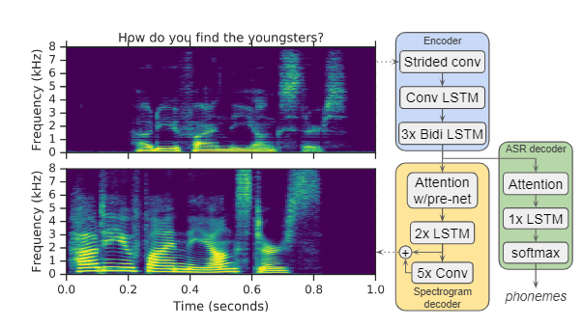
Generating clear speech from impaired audio
Literature Survey
Model architecture
Composed of an encoder and a decoder with attention, followed by a vocoder to synthesize a time-domain waveform.
The encoder converts a sequence of acoustic frames into a hidden feature representation which the decoder consumes to predict a spectrogram.

Slide 19
Generating clear speech from impaired audio
Literature Survey
Applications
Voice normalization
Addresses the task of normalizing speech from an arbitrary speaker to the voice of a predeﬁned canonical speaker.
Data: Model is trained on a ∼30,000 hour training set consisting of about 24 million English utterances which are anonymized and manually transcribed.
Metric used: Word Error Rates (WERs)
Metric score: The WER on the original speech (matched condition) is 8.3%, which is viewed as an upper bound. The best-performing Parrotron model yields 17.6% WER.

Slide 20
Generating clear speech from impaired audio
Literature Survey
Normalization of hearing-impaired speech
Investigates whether the normalization model can be used to convert atypical speech from a deaf speaker into ﬂuent speech.
Data: 15.4 hours of speech, corresponding to read movie quotes.
Metric used: Word Error Rates (WERs)
Metric score: The best ﬁnetuning strategy was adapting all parameters, and dramatically reduced the WER from 89.2% (real speech) to 32.7%.
Speech separation
Addresses the task of reconstructing the signal from the loudest speaker within a mixture of overlapping speech.

Slide 21
Generating clear speech from impaired audio
Literature Survey
Future work
In the future, they plan to test it on other speech disorders, and adopt techniques from [5, 6] to preserve the speaker identity.
Relevance of the paper to this project
This paper is relevant to this project as it demonstrates the ability of the model to handle speech from a deaf speaker, which is an example of an impaired speech
Since the model has a possible application in separating the loudest speaker among overlapping speakers, we could use this model to remove the background noise in the input speech thereby improving the speech clarity.

Slide 22
Generating clear speech from impaired audio
Literature Survey
2. Project Euphonia: Personalizing ASR for Dysarthric and Accented Speech with Limited Data [4]
T P Shriambhikesh (PES1UG21SC659)

Slide 23
Generating clear speech from impaired audio
Literature Survey
Abstract
This paper presents and evaluates fine tuning techniques to improve ASR for users with non-standard speech.
Personalized models trained using this approach bring 62% and 35% relative WER improvement over the standard ALS. Bringing the absolute WER down to 10% in mild dysarthria and 20% in severe dysarthria.
Proves that finetuning a particular subset of layers often gives better results than finetuning the entire model.

Slide 24
Generating clear speech from impaired audio
Literature Survey
Model architecture
A personalized ASR model by starting with a base model trained on standard, unaccented speech.(More resource efficient than retraining the entire model.)
This paper experiments with two different base models:
Bi-directional RNN-Transducer [i]
Listen, Attend and Spell(LAS) [ii]
Both are end to end sequence to sequence models
[i] R. Prabhavalkar, K. Rao, T. N. Sainath, B. Li, L. Johnson, and N. Jaitly, “A comparison of sequence-to-sequence models for speech recognition.” in Interspeech, 2017, pp. 939–943. [ii] W. Chan, N. Jaitly, Q. Le, and O. Vinyals, “Listen, attend and spell: A neural network for large vocabulary conversational speech recognition,” in 2016 IEEE International Conference on Acoustics, Speech and Signal Processing (ICASSP). IEEE, 2016, pp. 4960–4964.

Slide 25
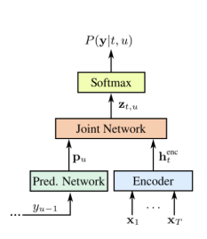
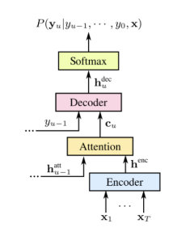
Generating clear speech from impaired audio
Literature Survey
Schematic Diagrams
RNN-T architecture
LAS architecture

Slide 26
Generating clear speech from impaired audio
Literature Survey
Finetuning
With RNN-T architecture, 1st, 2nd, and 3rd layer was finetuned in fixed combination on both datasets. Training from E_0 up (Where lower number represents layer closer to the input) with or without the joint layer produced promising results.
With LAS architecture, various combinations were tested and consistently found that best results from this network came from finetuning the entire network.

Slide 27
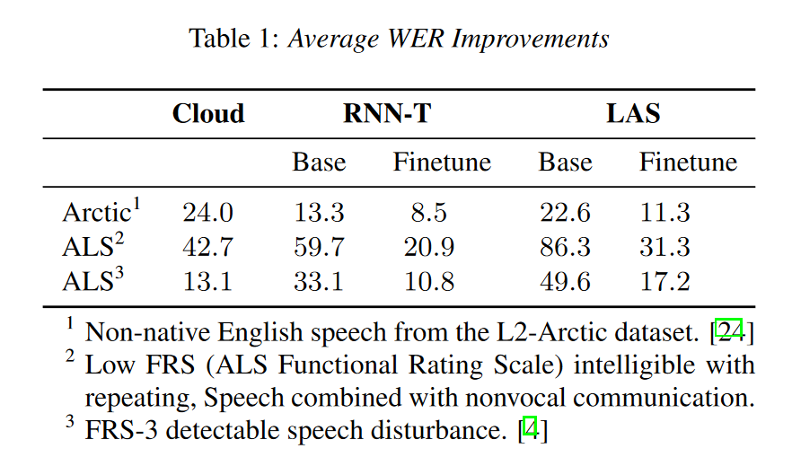
Generating clear speech from impaired audio
Literature Survey
Datasets
ALS
36.7 hours of audio from 67 people with ALS, in partnership with the ALS Therapy Development Institute.
Accented Speech
L2 Arctic dataset of non native speech, consists of 20 speakers with approximately 1 hour speech per speaker.

Slide 28
Generating clear speech from impaired audio
Literature Survey
Future Work
Open question on additional techniques that can be helpful in the low data regime ( Virtual Adversarial Training, data augmentation, etc.)
Explore pooling data from multiple speakers with similar conditions which where out of scope with respect to this paper.
Relevance
Explores and evaluates the technique of fine tuning already existing models using smaller datasets.

Slide 29
Generating clear speech from impaired audio
Literature Survey
3. Articulatory Features for ASR of Pathological Speech [4]
Vandana S (PES1UG21CS697)

Slide 30
Generating clear speech from impaired audio
Abstract:
This study investigates the joint use of Articulatory and Acoustic features in Automatic Speech Recognition (ASR) systems for pathological speech, particularly dysarthria. Despite extensive efforts, current ASR systems struggle with lower performance on pathological compared to normal speech. This is due to the high variability caused due to articulatory impairments.
To address this, a fused-featuremap convolution neural network (fCNN) that integrates articulatory and acoustic information is proposed. The fCNN is evaluated against conventional CNNs and time frequency convolutional networks (TFCNNs) using Dutch and Flemish pathological speech corpora.
Literature Survey

Slide 31
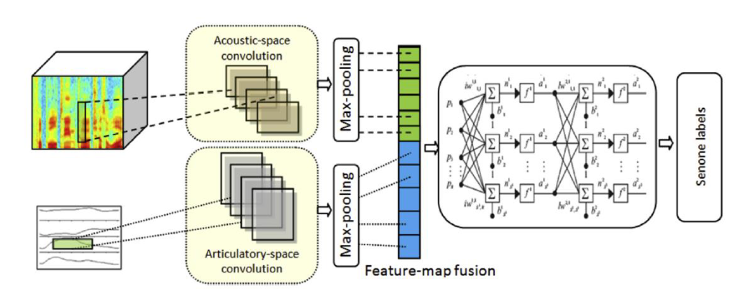
Generating clear speech from impaired audio
Literature Survey
Model Architecture:
The fCNN model proposed for dysarthric speech recognition combines acoustic and articulatory features to address ASR challenges.
It consists of two specialized convolutional layers: one for acoustic features, derived from filterbank energy, and another for articulatory features, specifically tongue and lip movement trajectories.
Max-pooling is applied post-convolution to extract salient features, which are fused before input to a single neural network.
This design enables comprehensive integration of acoustic and articulatory information, enhancing ASR performance for dysarthric speech.

Slide 32
Generating clear speech from impaired audio
Literature Survey
Training Dataset :
The EST Dutch dysarthric speech database. [10]
Components: Read speech, spontaneous conversations, interviews, and discussions.
Duration: Normal Flemish (FL) speech data: 186.5 hours, Northern Dutch (NL) speech data: 255 hours, EST Dutch dysarthric speech database (Dys. NL): 6 hours and 16 minutes from 16 speakers.
Exclusions: Segments with pronunciation errors, single words, and pseudowords were excluded to maintain the integrity of ASR performance evaluation.
Testing Dataset:
CHASING01 Dutch Dysarthric Speech Data [9]
Flemish COPAS Database [11]

Slide 33
Generating clear speech from impaired audio
Literature Survey
Results:
The results show that combining articulatory features with acoustic features improves speech recognition accuracy, especially for dysarthric speech.
In Dutch test sets, the fCNN model achieved the best performance with a Word Error Rate (WER) of 19.1%, surpassing other models like CNN and TFCNN.
In Flemish test sets, the fCNN model consistently outperformed others, especially when trained on combined Flemish and Dutch data.
This highlights the potential of using articulatory features to enhance ASR performance in pathological speech.
Notes:
TFCNN: Time-Delayed Fusion Convolutional Neural Network

Slide 34
Generating clear speech from impaired audio
Literature Survey
Metrics- Word Error Rate (WER): WER is used as the primary metric to evaluate the performance of ASR systems. It measures the percentage of words in the recognized output that differ from the reference transcription.
Future Works-
Further Investigation of Articulatory Features: Explore additional uses and benefits of articulatory features in ASR systems.
Model Optimization and Fine-Tuning: Improve performance and efficiency by optimizing hyperparameters and refining model architectures.
Robustness and Generalization: Assess how ASR systems handle variations in dysarthric speech characteristics and evaluate their ability to work across different languages and dialects.
User-Centric Evaluation: Conduct evaluations focusing on user needs and experiences to ensure the ASR systems meet their requirements effectively.
Integration with Assistive Technologies: Investigate integrating ASR systems with assistive technologies to improve accessibility for individuals with dysarthria. Additionally, explore real-time ASR applications for smoother communication in everyday situations.

Slide 35
Generating clear speech from impaired audio
Literature Survey
Relevance to Project:
Incorporating articulatory features alongside acoustic ones in ASR systems is crucial for addressing challenges in pathological speech.
This comprehensive approach enables a deeper understanding of unique speech patterns like dysarthria, leading to clearer communication.
Articulatory features also allow for tailored solutions, ensuring personalized communication for individuals with speech difficulties.

Slide 36
Generating clear speech from impaired audio
Literature Survey
4.Arabic Dysarthric Speech Recognition Using Adversarial and Signal-Based Augmentation [1]
Roseline Jerry A (PES1UG21SC500)

Slide 37
Generating clear speech from impaired audio
Abstract:
The authors address Arabic dysarthric automatic speech recognition by proposing a multi-stage augmentation approach. They first modify healthy Arabic speech to simulate dysarthric speech, then employ a Parallel Wave Generative adversarial model trained on English dysarthric data to further enhance the samples.
Additionally, they fine-tune an Arabic Conformer model and utilize text correction strategies for different dysarthric speech severity levels. The approach significantly improves word error rate (WER) by 81.8% compared to baseline on Arabic synthetic data and 124% on real English dysarthric speech.
Literature Survey

Slide 38
Generating clear speech from impaired audio
Literature Survey
Model architecture
The paper proposes a multi-stage augmentation approach to improve the performance of Arabic dysarthric automatic speech recognition.
The first stage involves a signal-based approach to generate dysarthric Arabic speech from healthy Arabic speech by modifying its speed and tempo.
The second stage utilizes a Parallel Wave Generative (PWG) adversarial model trained on an English dysarthric dataset to capture language-independent dysarthric speech patterns and further augment the signal-adjusted speech samples.

Slide 39
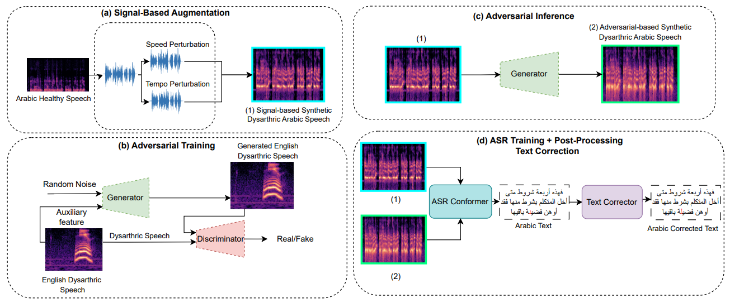
Generating clear speech from impaired audio
Literature Survey
Schematic Diagrams

Slide 40
Generating clear speech from impaired audio
Fine-tuning:
The fine-tuning process involves training the Conformer model on the signal-based augmented data, which includes dysarthric Arabic speech generated from healthy Arabic speech by modifying speed and tempo.
The fine-tuned Conformer model is evaluated based on Word Error Rate (WER) and Character Error Rate (CER) on synthetically generated dysarthric speech from the Arabic common voice speech dataset.
Literature Survey

Slide 41
Generating clear speech from impaired audio
Literature Survey
Datasets
The paper uses a combination of these datasets to train and evaluate their proposed augmentation approach for improving Arabic dysarthric speech recognition.
Common Voice dataset: healthy Arabic speech dataset used to generate synthetic dysarthric Arabic samples through signal-based perturbation.
MGB-2 dataset: healthy Arabic speech corpus used to train a Conformer model for Arabic ASR.
Torgo dataset: English dysarthric speech dataset used to familiarize the adversarial generator model with dysarthric speech characteristics beyond speed and tempo.
LJspeech dataset: English dataset used to synthetically generate dysarthric English speech for validation.

Slide 42
Generating clear speech from impaired audio
Literature Survey
Future Work
1. Explore additional variations beyond speed and tempo adjustments in the signal-based approach to address the complexities of dysarthric speech recognition.
2. Investigate the impact of variable recording conditions, uncontrolled body movements, and unbalanced data samples across speakers and diseases on dysarthric speech recognition.
3. Integrate the Parallel Wave GAN with the dataset to reconstruct further dysarthric speech variations introduced through the signal-based component.

Slide 43
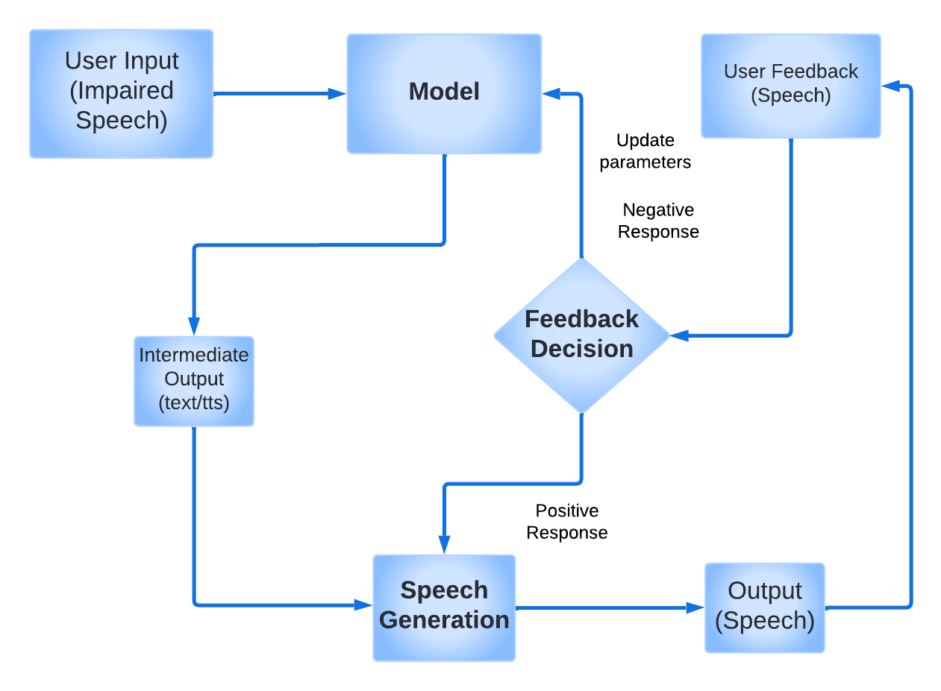
Generating clear speech from impaired audio
High Level Diagram
High Level Diagram
The impaired speech (e.g., stuttering, slurred speech) is fed into the model, which then generates a clear version of the input based on its prediction.
The other user can then give positive or negative feedback, which is used to retrain the model or generate the speech again using the same parameters.

Slide 44
Generating clear speech from impaired audio
Summary of Literature Survey
https://docs.google.com/spreadsheets/d/1qJRPP-TT6xekS5LKJDgvfMRfBl4YqoF6MQSnrsQbzT4/edit#gid=0

Slide 45
Generating clear speech from impaired audio
Conclusion
From our survey we understood that
The data scarcity challenges for non-standard speech
Use of techniques like adaptation, augmentation, multi-stream modelling and direct speech conversion to improve ASR performance and intelligibility for impaired or accented speech

Slide 46
Generating clear speech from impaired audio
References
[1] Baali, M., Almakky, I., Shehata, S., & Karray, F. (2023). Arabic Dysarthric Speech Recognition Using Adversarial and Signal-Based Augmentation. arXiv preprint arXiv:2306.04368.
[2] “Diagnosis of Disordered Speech using Automatic Speech Recognition,” International Journal of Engineering Research, vol. 8, no. 11, 2020.
[3] Fadi Biadsy, Ron J. Weiss, Pedro J. Moreno, Dimitri Kanevsky, Ye Jia, "Parrotron: An End-to-End Speech-to-Speech Conversion Model and its Applications to Hearing-Impaired Speech and Speech Separation," arXiv:1904.04169v3 [eess.AS], Oct. 29, 2019.
[4] J. Shor et al., “Personalizing ASR for Dysarthric and Accented Speech with Limited Data,” in Interspeech 2019, Sep. 2019, pp. 784–788. doi: 10.21437/Interspeech.2019-1427.
[1]

Slide 47
Generating clear speech from impaired audio
References
[5] A. Haque, M. Guo, and P. Verma, “Conditional end-to-end audio transforms,” in Proc. Interspeech, 2018.
[6] Y. Jia, Y. Zhang, R. J. Weiss, Q. Wang, J. Shen, F. Ren, Z. Chen, P. Nguyen, R. Pang, I. L. Moreno et al., “Transfer learning from speaker veriﬁcation to multispeaker text-to-speech synthesis,” in Advances in Neural Information Processing Systems, 2018.
[7] E. Yılmaz, V. Mitra, C. Bartels, and H. Franco, “Articulatory Features for ASR of Pathological Speech.” arXiv, Jul. 28, 2018.Available: http://arxiv.org/abs/1807.10948
[8] E. Yılmaz, M. Ganzeboom, C. Cucchiarini, and H. Strik, “Multistage DNN training for automatic recognition of dysarthric speech,” in Proc. INTERSPEECH, Sept. 2017, pp. 2685–2689.
[1]

Slide 48
Generating clear speech from impaired audio
References
[9] E. Yılmaz, M. Ganzeboom, C. Cucchiarini, and H. Strik, “Combining non-pathological data of different language varieties to improve DNN-HMM performance on pathological speech,” in Proc. INTERSPEECH, Sept. 2016, pp. 218–222.
[10] E. Yılmaz, M. Ganzeboom, L. Beijer, C. Cucchiarini, and H. Strik, “A Dutch dysarthric speech database for individualized speech therapy research,” in Proc. LREC, 2016, pp. 792–795.
[11] C. Middag, “Automatic analysis of pathological speech,” Ph.D. dissertation, Ghent University, Belgium, 2012.
[12] Jan Noyes, Clive Frankish (2009), "Speech recognition technology for individuals with disabilities,
Augmentative and Alternative Communication," 8:4, 297-303, DOI: 10.1080/07434619212331276333

Slide 49
Generating clear speech from impaired audio
References
[13] R. Prabhavalkar, K. Rao, T. N. Sainath, B. Li, L. Johnson, and N. Jaitly, “A comparison of sequence-to-sequence models for speech recognition.” in Interspeech, 2017
[14] V. Delvaux, K. Huet, M. Piccaluga, S. Van Malderen, and B. Harmegnies, “Towards a better characterization of parkinsonian speech: a multidimensional acoustic study,” in Interspeech, 2018.
[15] A. Hermes, J. Mertens, and D. M ̈ ucke, “Age-related effects on sensorimotor control of speech production,” Proc. Interspeech 2018, pp. 1526–1530, 2018.
[16] M. B. Mustafa, S. S. Salim, N. Mohamed, B. Al-Qatab, and C. E. Siong, “Severity-based adaptation with limited data for asr to aid dysarthric speakers,” PloS one, vol. 9, no. 1, p. e86285, 2014.

Slide 50
Generating clear speech from impaired audio
References
[17] N. Nonavinakere Prabhakera, P. Alku et al., “Dysarthric speech classification using glottal features computed from non-words, words and sentences,” in Interspeech, 2018.
[18] A. Hernandez, P. A. P ́ erez-Toro, E. N ̈ oth, J. R. Orozco-Arroyave, A. Maier, and S. H. Yang, “Cross-lingual self-supervised speech representations for improved dysarthric speech recognition,” in Interspeech 2022.
[19] J. Ren and M. Liu, “An automatic dysarthric speech recognition approach using deep neural networks,” International Journal of Advanced Computer Science and Applications, 2017.
[20] C. Bhat, A. Panda, and H. Strik, “Improved asr performance for dysarthric speech using two-stage dataaugmentation,” Interspeech 2022.

Slide 51
Generating clear speech from impaired audio
References
[21] D. Wang, J. Yu, X. Wu, L. Sun, X. Liu, and H. Meng, “Improved end-to-end dysarthric speech recognition via meta-learning based model re-initialization,” in ISCSLP. IEEE, 2021.
[22] Y. Matsuzaka, R. Takashima, C. Sasaki, and T. Takiguchi, “Data augmentation for dysarthric speech recognition based on text-tospeech synthesis,” in 2022 IEEE 4th Global Conference on Life Sciences and Technologies.
[23] X. Xie, R. Ruzi, X. Liu, and L. Wang, “Variational auto-encoder based variability encoding for dysarthric speech recognition,” in Interspeech 2021
[24] Z. Yue, E. Loweimi, and Z. Cvetkovic, “Raw source and filter modelling for dysarthric speech recognition,” in ICASSP. IEEE, 2022.

Slide 52
Generating clear speech from impaired audio
Thank You

